Slide 1
APACHE TOMCAT 7
Dima Ionut Daniel

Slide 2
CONTENTS
What is Apache Tomcat ?
Architecture
Deploy web application
Tomcat Manager Web Application
Tomcat Logging
Tomcat Security
Tomcat and SSL
Advanced Features
Tomcat server.xml components
Integrating Apache Web Server
Embedding Tomcat
Conclusion
Bibliography

Slide 3
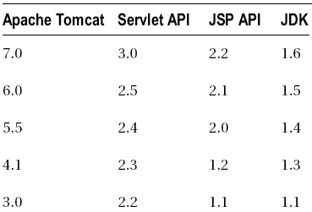

WHAT IS APACHE TOMCAT?
open source web server and servlet container developed by the Apache Software Foundation (ASF).
implements the Java Servlet and the JavaServer Pages (JSP) specifications from Oracle Corporation.
includes tools for configuration and management, but can also be configured by editing XML configuration files.
Tomcat 5.5X supports Servlet API 2.3, Tomcat 6.0X supports Servlet API 2.4, and the latest Tomcat 7.0 is a reference implementation of current Servlet API 3.0.
Tomcat started off as a servlet reference implementation by James Duncan Davidson, a software architect at Sun Microsystems. He later helped make the project open source and played a key role in its donation by Sun to the Apache Software Foundation.

Slide 4
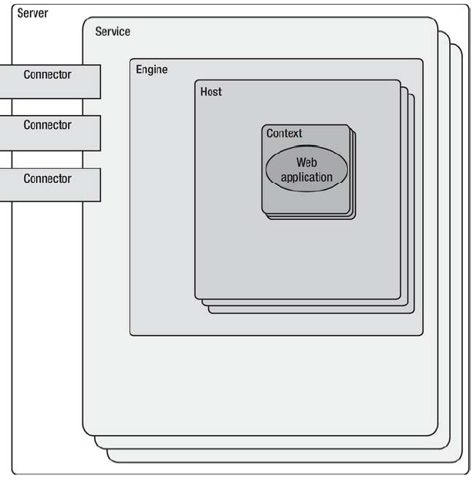
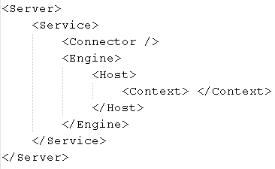
ARCHITECTURE

Slide 5
ARCHITECTURE (CONT.)
The key component in that hierarchy is the Catalina servlet engine. Catalina is the actual Java servlet container implementation as specified in Java Servlet API.
A Tomcat instance, or server can live in a single Java Virtual Machine (JVM). This instance can be broken down into a set of containers including a server, a service, a connector, an engine, a host, and a context. By default, each of these containers is configured using the server.xml file.
Server → It represents the entire Catalina servlet engine. The <Server> element may contain one or more <Service> containers.
Service → holds a collection of one or more <Connector> elements that share a single <Engine> element.
Connector → defines the class that does the actual handling requests and responses to and from a calling client application.
Engine → handles all requests received by all of the defined <Connector> components defined by a parent service.
Host → defines the virtual hosts that are contained in each instance of a Catalina <Engine>.
Context → represents an individual web application that is running within a defined <Host>. There is no limit to the number of contexts that can be defined within a <Host>.

Slide 6
ARCHITECTURE (CONT.)
Tomcat is by default accepting all requests on port 8080. Scratch from CATALINA_HOME/conf/server.xml: <Connector port="8080" protocol="HTTP/1.1" connectionTimeout="20000" redirectPort="8443" />
Tomcat 7 has a memory leak detection/prevention. It prevents memory leak through a new life-cycle listener: JreMemoryLeakPreventionListener.
Tomcat 7 has CSRF(Cross-Site request forgery) protection against malicious attack that compromises the site’s trust in the web browser making calls within an authenticated session.
Tomcat 7 can be embedded in an application and it can be configured and started programmatically.
Tomcat 7 has better security for the Manager and Host Manager applications.
Tomcat 7 can use alias to store static content outside war files.
Tomcat 7 supports Servlet 3.0, JSP 2.2, JSP-EL 2.2.
Tomcat 7 has asynchronous logging(AsyncFileHandler). The advantage of this approach is that if the I/O to disc is slow (e.g. log files on a remote drive), logging will not slow request processing.

Slide 7
ARCHITECTURE (CONT.)
The Tomcat installation directory is referred to as CATALINA_HOME. Subdirectories are described bellow:
/bin → startup and shutdown scripts for both Windows and Linux. Jar files with classes required for tomcat to start are also stored here(bootstrap.jar, commons-daemon.jar, tomcat-juli.jar).
/conf → main configuration files.Important are server.xml and the global web.xml.
/lib → Tomcat jar files, shared across all Tomcat components, including the Servlet API and JSP API libraries.
/logs → Tomcat’s log files.
/temp → temporary file system storage directory.
/webapps → directory where all web applications are deployed
/work → Tomcat’s working directory where Tomcat places all servlets that are generated from JSPs.
Catalina script (catalina.sh on Linux or catalina.bat for Windows) is responsible for starting and stopping Tomcat, and it accepts different command line arguments for different operations.

Slide 8
ARCHITECTURE (CONT.)
catalina start → starts Tomcat as a new detached process. (on Windows in the new command prompt window and on Linux in background), so you can continue using the command line.
catalina stop → stop Tomcat server
catalina run → starts Tomcat in the current window/terminal.
catalina debug → starts Tomcat in debug mode.
catalina configtest → checks if the current Tomcat configuration is correct. The script will try to start Tomcat and load all configuration files, and then exit gracefully in case the configuration is correct.
catalina jpda start → Starts Tomcat in Java Platform Debugging Architecture (JPDA) debug mode.
Additionally, the option –security(to any of the start commands),will enable the security manager. The security manager is the Java mechanism for protecting the Java managed resources from unauthorized access.
Two convenient scripts for starting and stopping Tomcat: startup.sh (and the corresponding startup.bat) and shutdown.sh (and shutdown.bat) are just thin wrappers around the catalina script.

Slide 9
DEPLOY WEB APPLICATION
The servlet architecture comprises two Java packages: javax.servlet and javax.servlet.http. At the heart of this architecture is the interface javax.servlet.Servlet. The three most important of these methods and their functions are: init, service, destroy.
init → servlet begins its life. This method is called immediately after the servlet is instantiated, and it is called only once. The init() method should be used to create and initialize the resources that it will be using while handling requests.
service → all requests are received from a client using a simple request/response pattern. The service() method takes two parameters, the first of which is a ServletRequest object that contains information about the service request, encapsulating information provided by the client. The ServletResponse object contains the information returned to the client.
destroy → signifies the end of servlet’s life. When a web application is shut down, the servlet’s destroy() method is called.
Servlet API 3.0 brought a few changes to the servlet development, namely annotation support for easier configuration, plug-ability using web fragments, and asynchronous servlets support.

Slide 10
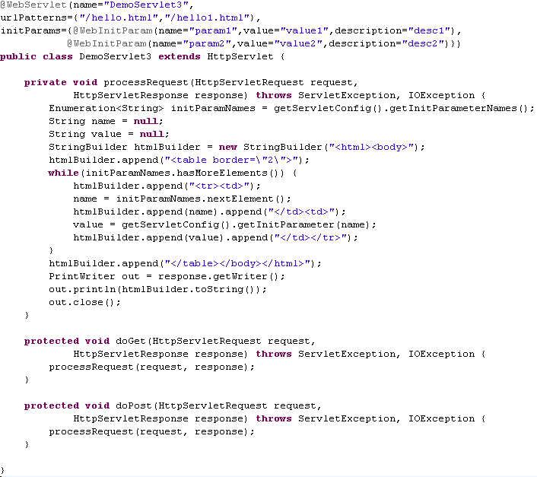
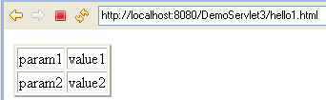
DEPLOY WEB APPLICATION (CONT.)

Slide 11
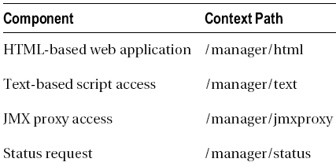
TOMCAT MANAGER WEB APPLICATION
The Tomcat Manager web application is packaged with the Tomcat server in the context path of /manager and provides the basic functionality to manage(install, start, stop, remove, and report) Web applications running in the Tomcat server.
Using Manager web application, you can easily deploy web applications on the local or remote server, without the need for FTP access to the server itself – all commands are invoked over HTTP protocol.
For advanced access when security is critical, Manager web application can be accessed via Java Management Extension (JMX) proxy.
Accessing status information of the Tomcat instance is also part of the Manager web application. We can see basic server stats from Tomcat’s status page, including the Tomcat version, Java version, OS version, and basic JVM memory and thread information. For convenience and easier access and security management, these four ways of accessing Tomcat’s Manager web application are accessible on separate contexts

Slide 12
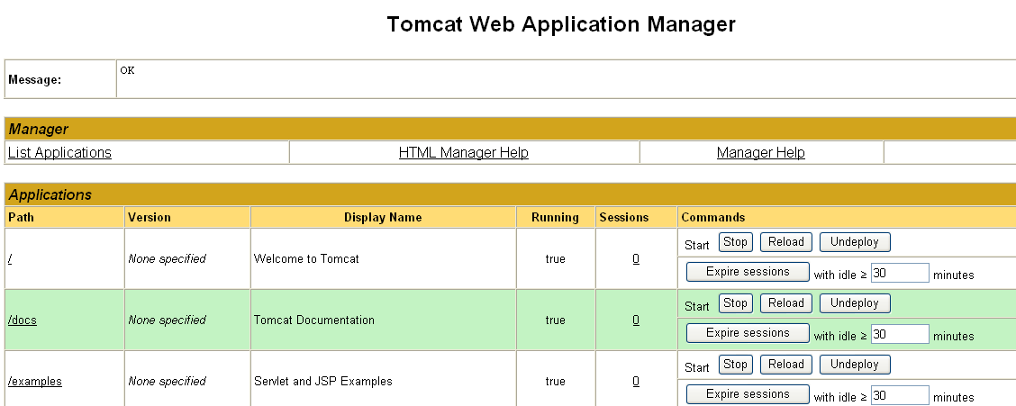
TOMCAT MANAGER WEB APPLICATION (CONT.)
Before you can use the Manager, you must set up a new user with the appropriate privileges to access the Manager web application. If you try to access any part of the Manager web application without setting up security privileges, you will be presented with a Tomcat error page, with standard HTML status code 403 - forbidden. For security reasons, a user shouldn’t be given more than one of the following roles: manager-gui, manager-status, manager-script or manager-jmx.
Tomcat’s users’ usernames, passwords, and roles are stored in file CATALINA_HOME/conf/tomcat-users.xml.
Tomcat uses the BASIC authentication mechanism for login, so the look and feel of the login box will depend of the OS and browser you are using.

Slide 13
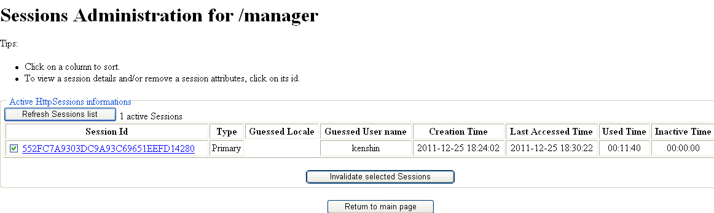
TOMCAT MANAGER WEB APPLICATION (CONT.)
The HTTP protocol that we use to communicate with server web applications is stateless, meaning each request is treated independently, with no information about previous requests from the same user. Tomcat associates each client with the session id, and then maintains the stateful information in the session. Every request contains the session id and, when it reaches the server, the session with that id is loaded and attached to request. Wecan see the number of associated user sessions for each web application on the Manager’s home page as the number in the Sessions column of the list of deployed applications. If haven’t accessed other applications recently, the value of the Sessions column for other listed applications will be zero.
Sessions are stored for a limited amount of time, configurable in your web application’s web.xml file. The default value is 30 minutes. We can invalidate all sessions for a particular web application by clicking the “Expire sessions” button in the Commands column.

Slide 14
TOMCAT LOGGING
Before debuggers were available, reading logs was the only way to find out what was going on with an application at runtime. Even with all the debugging tools available today, logs are still an invaluable tool for monitoring production systems and diagnosing any problems that occur on the deployed application.
Since version 1.4, Java itself comes with the capable logging package, java.util.logging (Java Logging framework).There is one problem with using it : it’s designed to have a single configuration within the JVM. Tomcat developers extended the functionality of the standard Java logging framework and the new implementation is known as JULI, and is part of Tomcat’s standard distribution. The package structure has been changed to avoid class-loading issues with JVM-wide logging, packaged in tomcat-juli.jar, located in the CATALINA_HOME/bin directory.
Logger logger = Logger.getLogger("com.mypackage");
Each logger accepts messages with different logging levels, based on their importance: SEVERE, WARNING, INFO, CONFIG, FINE, FINER, FINEST. The levels described are ordered hierarchically, so FINEST is the lowest logging level and it includes all levels above it.
Each logger has a list of handlers associated with it (represented by abstract class java.util.logging.Handler), which are responsible for writing log messages to its destination. There are three main handlers available in Java Logging framework: ConsoleHandler(outputs the logged messages to the JVM System.err output stream), FileHandler(writes the message to the file on disk, supporting file rotation), SocketHandler(writes messages to the network socket connection).

Slide 15
TOMCAT LOGGING (CONT.)
The last component of the Java Logging framework is the formater. There is always one formatter configured for each handler and its responsibility is to format the log messages before they are sent to output destination. Java Logging library (and Tomcat’s version JULI) comes with the two following formatters: SimpleFormatter and XMLFormatter. In addition to these two, JULI logging implementation adds three convenient formatters: OneLineFormatter(writes in a single line), VerbatimFormatter(writes the log message only, without any additional information), JdkLoggerFormatter(compact output format, with a timestamp in the millisecond format and abbreviated).
The logging configuration is typically specified in the file logging.properties.
The console output in Tomcat contains all messages sent to System.out and System.err output streams, and all exception stack traces. On Linux systems, and when running Tomcat as a windows service, Tomcat intercepts all console output and logs it to the file configured by CATALINA_OUT environment variable(default: CATALINA_HOME/logs/catalina.out). If you’re running Tomcat as a Windows service, console output will be appended to files CATALINA_HOME/logs/stdout.log and CATALINA_OUT/logs/stderr.out instead. Running Tomcat using startup.bat file on Windows, the console output will be redirected to the current Windows prompt window, and won’t be written to a file.
The Java Servlet specification defines the logging API to be used when logging messages. The logging based on Servlet API is performed by calls to ServletContext.log(String message) method, passing in the message to be written to the log.

Slide 16
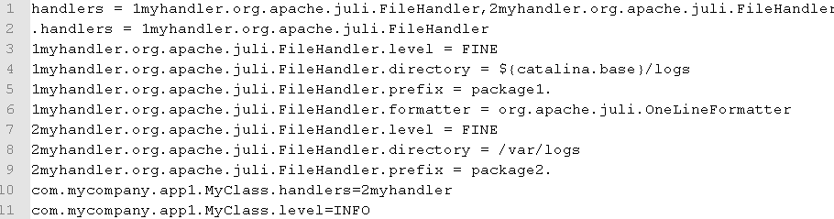
TOMCAT LOGGING (CONT.)
The first line of configuration defines all handlers that we are going to use. In the standard Java Logging framework, each handler is specified by its class name, as there is only one instance of each handler in JVM. Tomcat’s JULI implementation supports handler-per-classloader configuration, and that is reflected in the configuration by adding a prefix to each handler type. A handler prefix starts with a number, then has an arbitrary string, and ends with a period. We specify the default handlers using .handlers property. The default handlers will be used for loggers that do not have a specific handler configured.
Tomcat JULI logging framework rotates log files daily using the format: {prefix}{date}{suffix}. The new file is created at midnight every day, and used for logging until end of that day. The log file rotation is enabled by default, but we can control it using the rotatable property in your handler configuration: 1myhandler.org.apache.juli.FileHandler.rotatable = false

Slide 17
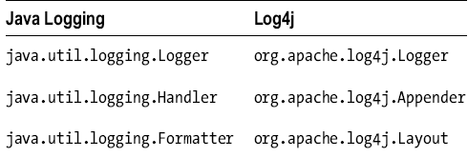
TOMCAT LOGGING (CONT.)
Sun has introduced Java Logging framework from Java version 1.4. Another logging framework: Log4j quickly gained popularity, becoming an open source project as part of the ASF. Just like with the Java Logging framework, logger is a central abstraction in Log4j.
Log4j uses different logging levels than Java Logging framework: FATAL, ERROR, WARN, INFO, DEBUG, TRACE. DEBUG and TRACE logging levels log huge amounts of information, and they should be turned off in production systems. They are analogous to FINE, FINER, and FINEST log levels in JULI.
To use Log4j, you have to place log4j-{version}.jar file on your application classpath. The configuration can be provided using the properties file (log4j.properties) or as XML file (log4j.xml).

Slide 18
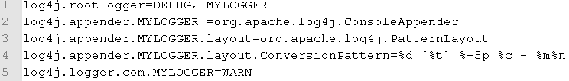
TOMCAT LOGGING (CONT.)
All configuration elements must start with string log4j. In Log4j, it’s mandatory to configure root logger, which will take over the logging for all loggers that are not explicitly configured. We haven’t specified the appender for com.foo logger and will inherit the appender from root logger in this case. Logger inheritance is mandatory in Log4j and is a very convenient mechanism for logging configuration.
Logger logger = Logger.getLogger(MyClass.class.getName());
Log4j contains a built-in list of appenders: ConsoleAppender, DailyRollingFileAppender, FileAppender, JDBCAppender, JMSAppender, SMTPAppender, TelnetAppender, SocketAppender, SyslogAppender, NTEventLogAppender, AsyncAppender, etc.
To use Log4j for logging, you’ll have to make to add log4j.jar library to the web application classpath (in the WEB-INF/lib directory of your web application). Then, you’ll have to place Log4j configuration file, log4j.properties, into the web application classpath as well (in the WEBINF/classes directory).

Slide 19
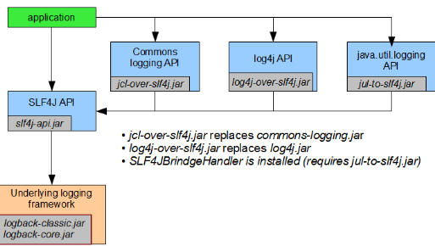
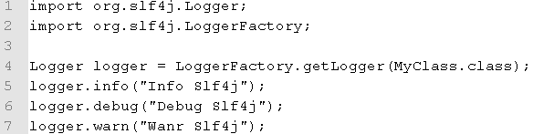
TOMCAT LOGGING (CONT.)
Both Log4j and Java Logging framework provide logging functionality that can be used in any Java project, but the biggest issue in choosing one or another is that you cannot switch easily. These frameworks use different libraries and configuration and have incompatible APIs(java.util.logging.Logger vs. org.apache.log4j.Logger).
Slf4j (Simple Logging Facade for Java), Java logging bridge library designed exactly for that reason. We need slf4j-api.jar library, which contains the Slf4j API classes and interfaces.
You can use the previously mentioned API calls in your code regardless of which underlying logging framework you decide to use. Slf4j will bridge these calls to the native API of logging library used. Slf4j achieves this by using bindings, the Java library that bridges the Slf4j API calls to the native logging calls.
Slf4j has bindings for all popular logging frameworks, including Java Logging framework, Log4j, commons-logging. We have to download the binding for your logging library, and add it to the application classpath.

Slide 20
TOMCAT SECURITY
A security realm is a Tomcat’s mechanism for protecting web application resources and gives the posibility to define the user roles that can access the protected resource. Tomcat’s realm can be defined as a collection of usernames, corresponding passwords.
A security realm is defined by the org.apache.catalina.Realm interface.
MemoryRealm → uses an xml file as a user store (tomcat-users.xml).
JDBCRealm → support storing usernames, passwords, and roles information in the SQL database.
JNDIRealm → JNDI implementation.
UserDatabaseRealm → custom UserDatabase configured via JNDI.
DataSourceRealm → Realm backed by a JNDI-configured JDBC data source.
JaasRealm → implementation using Java Authentication and Authorization Service (JAAS).
CombinedRealm → allows usage of multiple realms at the same time.
LockOutRealm → extends CombinedRealm, to lock out users if too many incorrect login tries are detected and prevents brute force server attack.
Custom implementation the Realm interface can be putted into CATALINA_HOME/lib as jar files.

Slide 21
TOMCAT SECURITY
If the <Realm> element is added under the <Engine> element of server.xml, all web applications served by the engine will have the realm enabled. If the <Realm> element is within the <Host> element, all web applications within that host will have the realm enabled. If the <Realm> element is within the <Context> XML element, only web applications that are defined for that context can use the configured realm.
Only one realm is active for each web application at any given time. The realm defined in <Engine> will apply to all web applications deployed on the server, unless it’s overridden by the <Realm> element under <Host>. Similarly, a realm defined under the <Engine> or <Host> elements can be overridden by a single web application-configured realm, under <Context> element.
It is a recommended approach to configure a realm on the web application level, within <Context> element to avoid confusion.
The MemoryRealm uses an in-memory user database read from an XML file on server startup. The default location of the MemoryRealm’s XML file is the <CATALINA_HOME>/conf/tomcat-users.xml.
<tomcat-users>
<user name="tomcat" password="tomcat" roles="tomcat" />
<user name="admin" password="admin" roles="admin" />
<user name="manager" password="manager" roles="manager" />
</tomcat-users>

Slide 22
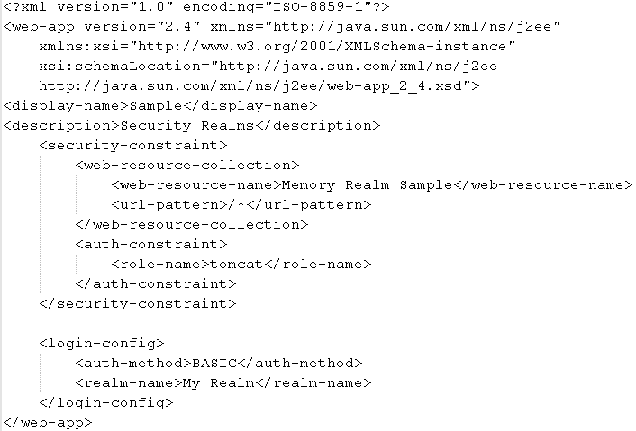
TOMCAT SECURITY
We define the <security-constraint> element as a holder for all security configurations for application. The element has two required child elements: <web-resource-collection>, which defines the URL path of the applications that are to be protected and <auth-constraint>, which defines authorization roles that a user accessing the protected URLs must have. The <web-resource-collection> element we define its name and the URL pattern that matches all web application URLs that we want to protect. We set the role name that is required for the access pages specified: "tomcat".

Slide 23
TOMCAT SECURITY
For login configuration we need to set the authentication method to use. Tomcat supports 4 types of authentication: BASIC, FORM, DIGEST, and CLIENT_CERT.
BASIC → client authenticates by entering a username and password to a built-in browser login window. The browser sends the username and password in HTTP header in plain text, Base64 encoded. The username and password are then decoded on the server.
FORM → client authenticates using HTML form by entering a username and password. The sending mechanism, password encoding, and the style of the HTML form are customizable by the user. The form attributes are defined as part of Java Servlet specification (input field names and form action attributes).
DIGEST → Similarly to BASIC authentication, this uses the browser’s login window to collect credential details and send them to the server as HTTP header. Unlike with BASIC authentication, usernames and passwords are digested encoded using MD5 algorithm, which is a one-way hash function, so the username and password cannot be decoded making authentication more secure. Some older browsers do not support DIGEST authentication.
CLIENT_CERT → this authentication type uses Secure Socket Layer (SSL), where both the client (user) and the server have their own SSL certificates, which are used
for mutual authentication.

Slide 24
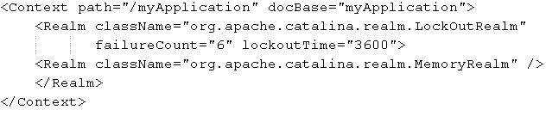
TOMCAT SECURITY
A common approach for preventing brute force attacks is to lock out users for a given period of time if they enter an incorrect password too many times. The LockOutRealm is a simple CombinedRealm, which encapsulates any other realms we use.
failureCount → how many failed attempts a user can have before being locked out. Default is 5.
lockoutTime → how long (in seconds) the user will be locked out if the failureCount has been exceeded. Default is 300.

Slide 25
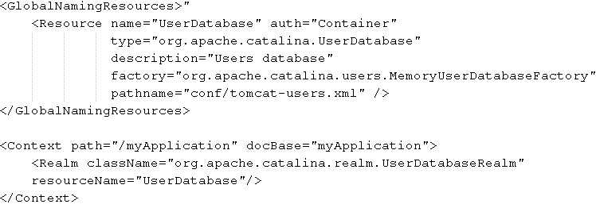
TOMCAT SECURITY
UserDatabaseRealm is an advanced version of the MemoryRealm and the users database is backed with the same XML file(which defaults to CATALINA_HOME/conf/tomcat-users.xml by default). The advantage of the UserDatabaseRealm is that it’s configurable via the JNDI.
The JNDI resource is configured within the <GlobalNamingResources> element in server.xml. We can configure the custom path for your user database file, but it has to have same XML format.
Using a JNDI-backed resource allows easy access - either programmatically (using JNDI API) or using JMX, and changing the user’s details without needing to change the XML file on the disk.

Slide 26
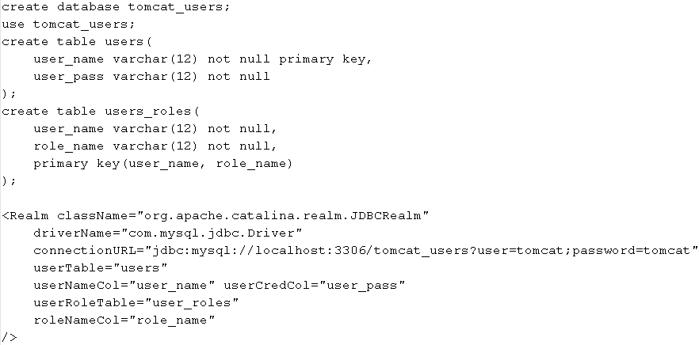
TOMCAT SECURITY
JDBCRealm stores all of its users in a user-defined and JDBC-compliant database.
Before configuring Tomcat to use a JDBCRealm, we must first create a database to hold your collection of users. In order to store user information JDBCRealm requires two tables in the database schema.
The first table will store the usernames and passwords of all users, and must contain at least two text columns: one for usernames and one for passwords. The second table will store the roles for every user and must have two text columns.

Slide 27
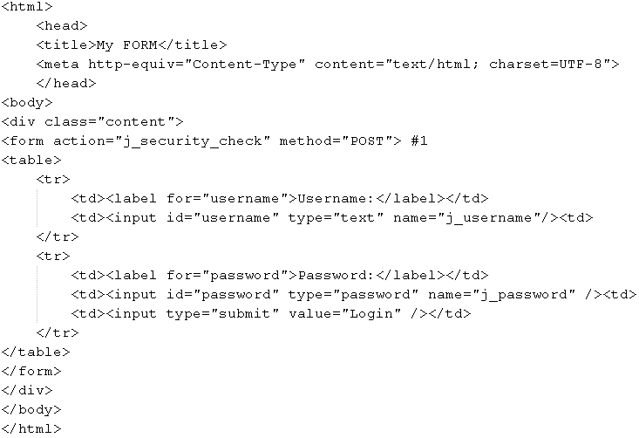
TOMCAT SECURITY
For FORM authentication method the action attribute is set to j_security_check and the fields names must be j_username and j_password – agreed as part of Java Servlet specification.

Slide 28
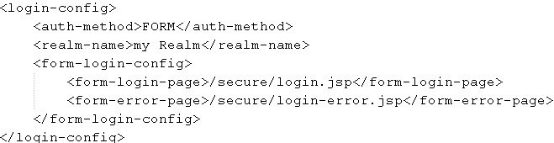
TOMCAT SECURITY
form-login-page → the page to be rendered when a user requests a secure resource, but is not authenticated.
form-error-page →the page to be rendered when user credentials are not recognized.
The actual login page and login error page must not be protected – so unauthenticated user can access those pages to log in.

Slide 29
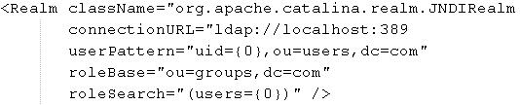
TOMCAT SECURITY
LDAP stands for Lightweight Directory Access Protocol, and it’s a protocol for accessing directory-based resources over IP networks. LDAP is most often used as a user data storage and authentication system within large organizations.
Tomcat supports authentication using LDAP server via its JNDIRealm implementation.
JNDIRealm is configured to access an LDAP directory via a JNDI provider and provide data for the authentication and authorization of users in Tomcat. We need to do it add a <Realm> element in the CATALINA_HOME/conf/server.xml file.
In the pattern, {0} will be replaced by the actual username.

Slide 30
TOMCAT AND SSL
Secure Socket Layer (SSL) is a secure transfer protocol used for communication using cryptographic methods. SSL uses symmetric pair of keys to encrypt and decrypt traffic sent over the Internet. When the user accesses the web server for the first time, the server sends its SSL certificate, or public key, to the client. The SSL certificate contains the information about the server, its owner, company, and its validity period. A user can reject a certificate if it does not trust its authenticity, effectively terminating the connection. If the user accepts the certificate, the certificate itself is stored in the browser, and is used to initiate a secure connection with the server.
The key received from the server is public. The information encoded using the public key can only be decoded using the private key which is kept safely on the server. A client generates the symmetric(session) key, with which both client and server will encrypt all traffic sent to the other side. With the symmetric(session) key, content is encoded and decoded using the same key known to both parties in the communication.
A client encodes the symmetric key using the server’s public key (received in the certificate), and the server encodes it using its private key. When a server receives the symmetric key, the connection between server and client is secure.
The security of SSL depends on how secure the key used to encrypt data is. For the industry-standard 128-bit key there are 2128 combinations(240 trillion trillion trillions) possible to generate the key.
Asymmetric algorithm is used in SSL for privately share the (symmetric)session key.
Symmetric algorithm is used in SSL for encrypting the session data.

Slide 31
TOMCAT AND SSL
SSL protocol communication over HTTP protocol is referred to as HTTPS (secure HTTP).
Certificate Authorities (CA) can authenticate the details of the SSL certificate, so if the user trusts the CA, they can be sure that the secure web site is certified, and its details are correct.
All publicly known certificates are stored in a repository called the keystore. The keystore is a file that contains the public and private key data required to encode and decode information using SSL or TLS. Applications that are using SSL must be able to read the keystore file, and use its data as keys to encrypt and decrypt information.
Apache Tomcat 7 can read keystores in one of the following formats: PKCS11, PKCS12, and JKS(Java KeyStore). JKS keystore can be created and manipulated using the keytool utility application(JAVA_HOME/bin/keytool).
keytool -genkeypair -alias tomcat -keyalg RSA -keystore C:\mykeystore
Because one keystore can contain multiple public/private key pairs, we use the alias "tomcat" to identify the certificate within the keystore. When we press Enter, we will first be prompted for the keystore password.
We can only have one SSL certificate for one IP address.
To configure the <Connector> element for SSL we have to set the SSLEnabled, scheme, secuure attributes to true.

Slide 32
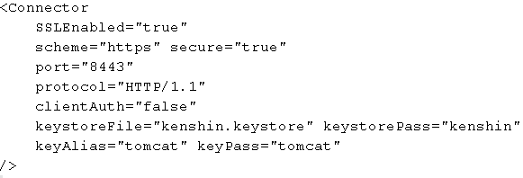
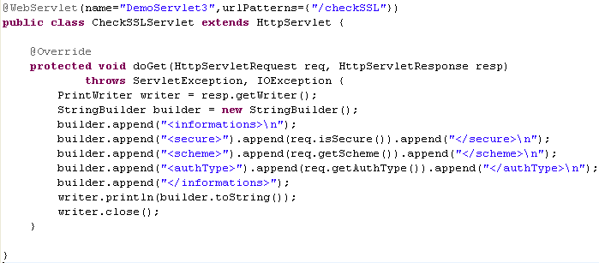

TOMCAT AND SSL
To check the SSL connection we can call HttpServletRequest.isSecure() method.
The clientAuth attribute specifies whether we are using one-way secure certificate authentication or if the client needs to present the valid SSL certificate to the server. To establish a secure connection, it is enough that the client accepts the certificate from the server. Sometimes the server requires the client to be authenticated as well.
We set the scheme attribute to value https, so that all SSL-secure URLs are recognized by the standard https:// protocol identifier.

Slide 33
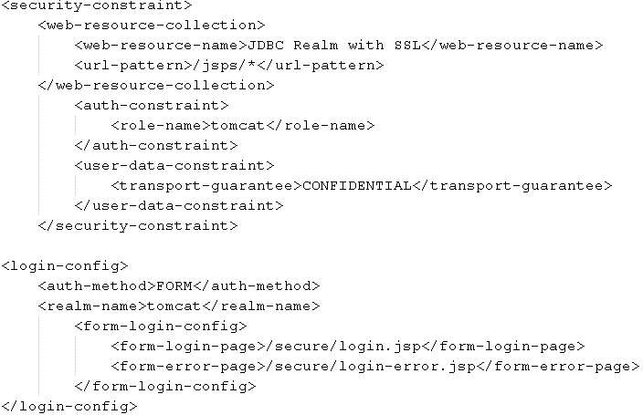
TOMCAT AND SSL
For all resources in the configured collection, we apply a security constraint using <user-data-constraint> element.
This element requires that transport guarantee be configured, which we set to value CONFIDENTAL forcing Tomcat to secure the channel (HTTPS) for all resources that match the <web-resource-collection> configuration.
If a user tries to load a secure page(resource) automatically redirects user to the secure URL.

Slide 34
TOMCAT AND SSL
Session-tracking mechanism consist in the JSESSIONID cookie in the browser. Other mechanism is URL rewritin where the session identifier is passed as request parameter with every URL pointing to a web application.
From Tomcat 7 a third mechanism exists: using SSL protocol for session tracking. SSL session tracking is actually part of Java Servlet specification 3.0. If your application is not using SSL exclusively, you will not be able to use the SSL session-tracking mechanism. When tracking sessions using SSL, the session identifier actually is the id of the established SSL session, generated by the server at the start of the SSL handshake when the client (browser) requests the SSL certificate from the server. The SSL session identifier is passed over an encrypted SSL connection along with all other traffic. This is the most secure way to track a session between server and client.
We can only use SSL session tracking with standard Java connectors, both blocking (BIO) and nonblocking (NIO). The APR Tomcat native connector does not yet support the SSL session tracking.
We need to enable Tomcat to use the SSL session tracking mechanism because by default, Tomcat checks all available session-tracking modes before deciding which strategy to use. In addition, cookie strategy and URL rewriting mechanisms take precedence over SSL session tracking. To use SSL session tracking within the application, we must explicitly set this mode using custom ServletContextListener.

Slide 35
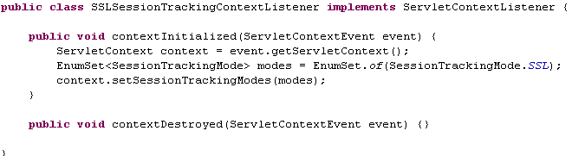
TOMCAT AND SSL
The configured listener will be instantiated, and its contextInitialized() will will ensure that Tomcat uses SSL session identifier to track session in our web application.
The SSL session id is available as request attribute javax.servlet.request.ssl_session or from HttpSession object invoking the getId() method.
<%= request.getAttribute("javax.servlet.request.ssl_session") %>

Slide 36
TOMCAT AND SSL
When using SSL session tracking, we should pay special attention to session invalidation. We have to make sure you invalidate both standard HTTP session and Tomcat’s SSL session.
HttpSession session = request.getSession(true);
// invalidate standard HTTP session
session.invalidate();
// Invalidate the SSL session
SSLSessionManager mgr = (SSLSessionManager)
request.getAttribute("javax.servlet.request.ssl_session_mgr");
mgr.invalidateSession();
response.setHeader("Connection", "close"); // Close the conection
We use Tomcat’s SSLSessionManager class to invalidate the underlying SSL session.
The above cleanup code is currently only available for the BIO and NIO connectors, not the APR/native connector.

Slide 37
ADVANCED FEATURES
Valves and filters were invented for the purpose of intercepting requests for one or more web applications. Tomcat Valve, is a proprietary Tomcat technology. Servlet filters are a server-independent technology introduced as part of the Java Servlet specification (version 2.3). These are used for: security, encoding, data compression, locale, etc.
A Tomcat Valve allows the association of an Java class instance with a particular Catalina container. These classes are called valves and they implement the org.apache.catalina.Valve interface. Tomcat ships with a convenient abstract class: org.apache.catalina.valves.ValveBase class.After processing, each valve can give control to the next valve in the chain, or stop processing altogether, effectively blocking the incoming request.
Valves can be configured with any of the Tomcat Catalina containers: Engine, Host, or Context in the CATALINA_HOME/conf/server.xml configuration file. If we configure a valve with the Engine container, the configured valve will process all requests to all web applications in all hosts for that engine.
Valves and filters have a similar functionality. Because filters are part of the Java Servlet specification have gained popularity, beeing platform independent.
The abstract ValveBase class has only one method that a developer needs to implement: invoke(Request request, Response response). This method should give control to the next configured valve for Tomcat after successful invocation by calling getNext().invoke(request, response) method.

Slide 38
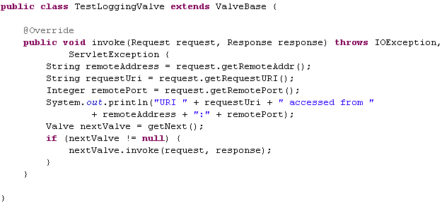
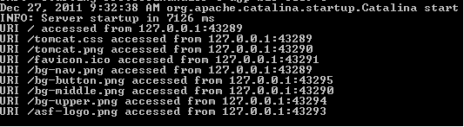
ADVANCED FEATURES
We need to include catalina.jar and servlet-api.jar from the CATALINA_HOME/lib to compile the implementation of the valve . Built the jar file that includes the valve implementation and copy it to the CATALINA_HOME/lib directory, as that directory is on the Tomcat classpath by default. Add this line in the server.xml configuration file:
<Valve className="com.mypackage.TestLoggingValve" />

Slide 39
ADVANCED FEATURES
Tomcat have some built-in valves in the org.apache.catalina.valves package .
AccessLogValve → creates log files to track client access information
RemoteAddrValve → allows you to compare the IP address of the requesting client against one or more regular expressions to either allow or prevent the request from continuing . (<Valve className="org.apache.catalina.valves.RemoteAddrValve" deny="127.*"/>). All clients with an IP address beginning with 127 will see a standard error page for HTTP status code 403 – Forbidden.
CrawlerSessionManagerValve → ensures that each unique web crawler is associated with exactly one user session, saving memory and improving performance of web application. Each crawler is uniquely identified by its user-agent header, which is the same for every crawler process that accesses the Tomcat server. We can find a list of crawlers and bots to www.user-agents.org.
<Valve className=" org.apache.catalina.valves.CrawlerSessionManagerValve“ crawlerUserAgents="*[bB]ot.*|.*Yahoo! Slurp.*” sessionInactiveInterval="3600” />
DeadThreadDetectionValve → detects the stuck threads(programming bugs,network problems, others) and logs them as warnings. (<Valve className=" org.apache.catalina.valves. DeadThreadDetectionValve” threshold="300” />)

Slide 40
ADVANCED FEATURES
Java Naming Directory Interface (JNDI) is the standard Java API for directory and naming services. JNDI is a Java API for accessing and manipulating named resources.
Naming services store a number of bindings, which bind the unique name to an object. These objects represent services available on the server that clients can look up and use. A service object usually defines an interface, so that clients can invoke its methods without any knowledge of the internal implementations.
Clients need to know the service name and the interface it implements.
JNDI-configured resources are used to configure resources in production, mainly for its portability and easy configuration.
The main interface in the JNDI API is javax.naming.Context and defines methods to create, update, and examine the bindings stored in the naming context by their name.
The JNDI resource in Tomcat is configured using the <Resource> XML element. JNDI resources in Tomcat can be defined as global resources available to all contexts deployed on the Tomcat instance or as <Context> elements available to the web application defined in that context only. If the JNDI resource is configured as global, the <Resource> element needs to be placed within the <GlobalNamingResources> in the server.xml configuration file.

Slide 41
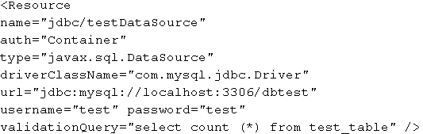
ADVANCED FEATURES
name → name of the resource, relative to the root Java context, java:comp/env.
description → human readable description of the JNDI resource.
auth → authentication for the resource access is container-managed or application-managed. Allowed values are Container and Application.
type → fully qualified class name for the type of object returned for any JNDI lookup of this resource.
scope → the object looked up using this resource can be shared. Allowed values are Shareable and Unshareable. The default value is Shareable.
singleton → Specifies whether multiple lookups of the resource will return a new Object every time (when set to false), or whether the same Object will be reused (when set to true). Default is true.
closeMethod → Name of the method used to perform cleanup after the singleton resource is no longer required. Method specified must not accept any arguments.
validationQuery → Tomcat executes this query each time before it passes Connection object to application, in order to check the accessibility of the database.

Slide 42
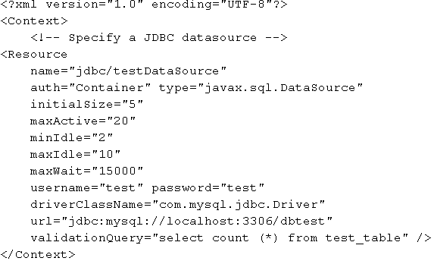
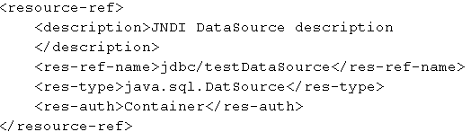
ADVANCED FEATURES
We create reference to the configured JNDI resource in the web deployment descriptor file (web.xml). The <res-ref-name> element specifies the name of the JNDI resource configured in Tomcat configuration files.
The META-INF/context.xml file from the web application contains the <Resource> concrete definition.
The attribute initialSize specifies the number of Connection instances created on server startup. The maxWait attribute represents the maximum amount of time to wait to get new Connection if none is available in the pool. The default value is -1, which means indefinite time to wait. If the time waiting for the new Connection is exceeded, connection pool will throw an exception.

Slide 43
ADVANCED FEATURES
Session management in Tomcat is the responsibility of the session manager, defined with interface org.apache.catalina.Manager and is configured in the TOMCAT_HOME/conf/context.xml file. Tomcat 7 comes with several Manager implementations in the org.apache.catalina.session and org.apache.catalina.ha.session packages.
StandardManager → Default manager implementation, with limited session persistence, for a single Tomcat instance only.
PersistentManager → Configurable session manager for session persistence on a disk or relational database. Supports session swapping and fault tolerance.
DeltaManager → Replicates session across the cluster, by replicating only differences in session data on all clusters. Used in a clustered environment only.
BackupManager → Replicates session across the cluster by storing backup of all sessions for all clustered nodes on a single, known, backup node. Used in a clustered environment only.
StandardManager is the default session manager implementation on Tomcat 7. StandardManager stores user sessions on disk between server restarts by default. The sessions are stored in the work directory for each web application, in the file SESSIONS.ser. Only active sessions are persisted to this file; all inactive sessions are lost after every Tomcat restart, if you are using StandardManager. Because StandardManager persists sessions only on graceful server shutdowns, in the case of an unexpected server crash, no session will be saved.

Slide 44
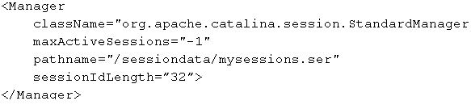
ADVANCED FEATURES
If we want to customize the behavior of the StandardManager, you will need to configure it manually in Tomcat’s context.xml file. The session manager is configured using the <Manager> element, within the <Context> element in the context.xml file. Bellow are some common attributes for <Manager> element.
className → fully qualified class name of the Manager to use.
distributable → manager should enforce distributable application restriction, as specified in the Servlet API—meaning that all session attributes implement java.io.Serializable interface. Default is false.
maxActiveSessions → maximum number of sessions that can be created. By default, there is no limit (value is -1).
maxInactiveInterval → The maximum time interval after which session can be marked as inactive, in seconds. The default value is 60. This attribute is overridden by Tomcat’s or the specific web application’s session-timeout value configured in web.xml.
sessionIdLength → the length of the session identifier, in bytes.

Slide 45
ADVANCED FEATURES
PersistentManager has the ability to swap out idle sessions to external storage. Idle sessions are those that are still active, but are not accessed for a configured period of time (the default is 60 seconds), so they can be stored away temporarily while session of the users currently active can be loaded to memory.
PersistentManager persists session using the org.apache.catalina.Store interface. Tomcat currently comes bundled with two implementations of the Store interface: org.apache.catalina.session.FileStore and org.apache.catalina.session.JDBCStore.
saveOnRestart → signifies that all active sessions will be saved to the persistent store when Tomcat is shut down. All expired sessions are ignored during shutdown and startup.
minIdleSwap → minimum length of time, in seconds, that a session can remain idle before it is swapped out to the persistent store. If value is -1, then there is no minimum time limit before a swap can occur.
maxIdleSwap → maximum length of activity after which the session should be swapped to disk. The default value is -1, which disables this feature entirely.
maxIdleBackup → the length in time, in seconds, that a session can remain idle before it is backed up to the persistent store. If value is -1, no sessions are backed up.
processExpiresFrequency → how often the background process for checking the session expiration is going to run. Default value is 6.
secureRandomClass → class used to generated session ids, must extend java.security.SecureRandom, which is the default option.
secureRandomAlgorithm → random algorithm used; default value is SHA1PRNG.

Slide 46
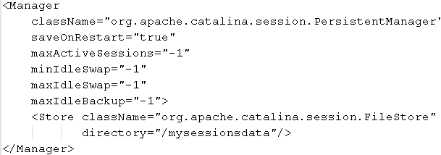
ADVANCED FEATURES
Tomcat will need to track the active requests for each session. Tomcat does not do this by default, in order not to affect performance and memory we need to change the following java envirnoment properties:
JAVA_OPTS="org.apache.catalina.session.StandardSession.ACTIVITY_CHECK=true", or JAVA_OPTS=" org.apache.catalina.STRICT_SERVLET_COMPLIANCE=true“
PersistentManager requires the Store element be configured as a nested element.
For JDBCStore we create the tomcat_sessions database and a user plus we grant access to the required database to the user created.
CREATE USER 'tomcat'@'localhost' IDENTIFIED BY 'tomcat';
grant all privileges on tomcat_sessions.* to tomcat@localhost ;
The database that we can be use with JDBCStore, has to have one table for storing session data, with well defined columns for specific data types. The table name, and the column names are fully configurable, so you can decide on which names to use.

Slide 47
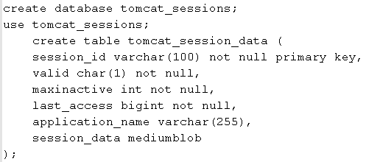
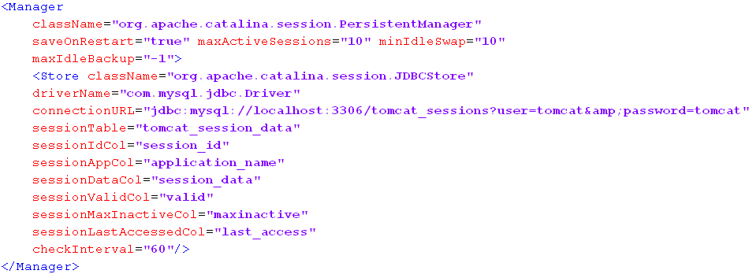
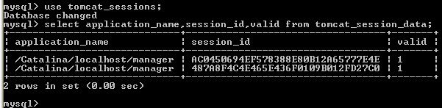
ADVANCED FEATURES

Slide 48
ADVANCED FEATURES
session_id → string representation of the unique session ID. The id has a type of varchar(100) and it’s primary key.
application_name → the name of the web applications engine, host, and context are stored in this context, separated by forward slash; (/Catalina/localhost/manager). The column’s datatype is varchar(255).
valid → the valid column contains a single character that represents whether the session is valid or invalid. The valid column has a type of char(1).
maxinactive → integer representing the length of time that a session can remain inactive before becoming invalid.
last_access → integer representing the the length of time since the session was last accessed.
session_data → the serialized representation of the HTTP session. The data column has a type of mediumblob.

Slide 49
TOMCAT SERVER.XML COMPONENTS
Tomcat server.xml important elements:
  Server
  Service
  Engine
  Host
  Context
  Connector

Slide 50
TOMCAT SERVER.XML COMPONENTS (SERVER)
There are several types of Tomcat containers, each of which is configured within the server.xml based upon its type.
The server container is defined by the org.apache.catalina.Server interface and it's configured with the <Server> XML element.It's a singleton element that represents the entire Tomcat JVM and may contain one or more Service containers.
className → names the fully qualified Java name of the class that implements the org.apache.catalina.Server interface. Default implementation is org.apache.catalina.core.StandardServer.
address → the TCP/IP address on which this server listens for the shutdown
command. Default value is localhost, which means that the server can be shut down
from the same machine where it is installed (i.e., remote shutdown is disabled).
port → the TCP/IP port number on which the server listens for a shutdown command. If you’re running Tomcat as daemon (i.e.,as Windows service), we can disable shutdown port by setting this value to -1. (mandatory attribute)
shutdown → defines the command string that must be received by the server on the configured address and port to shut down Tomcat. (mandatory attribute)
The default server.xml distributed with Tomcat uses:
<Server port="8005" shutdown="SHUTDOWN">
…
</Server>

Slide 51
TOMCAT SERVER.XML COMPONENTS (SERVICE)
The service container holds a collection of one or more connectors, and a single engine container and it's configured using the <Service> XML element. Multiple service containers can be configured within the same server container. The service container element is defined by the org.apache.catalina.Service Java interface.
className → names the fully qualified Java name of the class that implements the org.apache.catalina.Service interface. Default value: org.apache.catalina.core.StandardService.
name → name of the defined service. The service name must be unique within the enclosing server container.
<Service name="Catalina">
…
</Service>
Multiple service containers can be configured within the same server container.
The <Service> XML element is configured as a child of the <Server> element and contains <Connector> element/(s) and <Engine> element.

Slide 52
TOMCAT SERVER.XML COMPONENTS (ENGINE)
Engine container is configured in the server.xml file using the <Engine> XML element. The <Engine> element must be nested after the <Connector> elements, inside its owning <Service> element.
The <Engine> element is defined by the org.apache.catalina.Engine interface.
Engine container represents the heart of the request-processing mechanism in Tomcat, responsible for processing all incoming requests from configured connectors and returning the processed response back to the connector for dispatching to the calling client.
className → fully qualified Java name of the class that implements org.apache.catalina.Engine. Default: org.apache.catalina.core.StandardEngine.
defaultHost → names the host name to which all requests are defaulted.
name → defines the logical name of this engine. The name defined is used in log messages, and must be unique within the server component.
backgroundProcessorDelay → Defines the delay time in seconds before the child containers’ background processes will be invoked, in case they are executing in the same thread. Default value is 10.
jvmRoute → String identifier appended to every session in load balancing scenarios. If configured, the value of jvmRoute must be unique among all servers in a cluster.
Sample: <Engine name="Catalina" defaultHost="localhost">
The <Engine> element is configured as a child of the <Service> element, and as a parent to the following elements: Host, Realm, Valve, Listener.

Slide 53
TOMCAT SERVER.XML COMPONENTS (HOST)
The host container is configured using the <Host> XML element within the <Engine> element. We must define at least one <Host> for each <Engine> element, and the name of one defined host must match the defaultHost attribute of the parent engine container. The default <Host> element is usually named localhost.
The host container links the server machine where the Tomcat is running to the network name.
className → qualified Java name of the class that implements the org.apache.catalina.Host. Default value: org.apache.catalina.core.StandardHost.
name → defines hostname of this virtual host.
appBase → directory for this virtual host. This directory is the pathname of the web applications to be executed in this virtual host.
xmlBase → The directory location of the XML deployment descriptors that are deployed to this host.
createDirs → specifies whether the directories specified in appBase and xmlBase attributes should be created on Tomcat startup. The default value is true.
autoDeploy → Specifies whether Tomcat should check for new or updated web applications to be deployed to this host. The default is true.
deployIgnore → regular expression pattern that specifies directories to skip when performing auto deployment, for example *.svn*.
deployOnStartup → Specifies if the web applications found in appBase and xmlBase directories should be deployed on server startup. The default value is true.

Slide 54
TOMCAT SERVER.XML COMPONENTS (HOST)
backgroundProcessorDelay → the delay time in seconds between the background process method invocation on this container and any child containers. The default value is -1, which means that this host will rely on the delay setting of its parent engine.
unpackWARs → Determines if WAR files should be unpacked or run directly from the WAR file. Default value is true.
workDir → specifies the work directory for all web applications deployed to this host. If not specified, the default value is CATALINA_HOME/work.
copyXML → If set to true, the context configuration file specified within the web application (/META-INF/context.xml) should be copied to the xmlBase directory. The default value is false.
deployXML → specifies whether the context configuration supplied with web application (/META-INF/context.xml) should be parsed during web application deployment. Default value is true.
errorReportValveClass → Configures the valve responsible for rendering the Tomcat error pages. By default, the host will use org.apache.catalina.valves.ErrorReportValve.
The <Host> element is configured as a child of the <Engine> element, and can have the following nested XML elements: Context, Realm, Valve, Listener.
<Host name="localhost" appBase="webapps” unpackWARs="true" autoDeploy="true">

Slide 55
TOMCAT SERVER.XML COMPONENTS (CONTEXT)
The context container represents a single web application deployed to Tomcat and it's configured by <Context> XML element. We can define any number of contexts within a <Host>, but each <Context> definition must have a unique context path. There are over 50 different attributes that you can configure for the <Context> element.
className → fully qualified Java name of the class that implements the org.apache.catalina.Context. Default: org.apache.catalina.core.StandardContext.
cookies → determines if you want cookies to be used for a session identifier. The default value is true.
crossContext → if set to true, allows the ServletContext.getContext() method to successfully. return the ServletContext for other web applications running in the same host. Default value is false, which prevents the access of cross context access.
docBase → defines the directory for the web application associated with this <Context>. This is the pathname of a directory that contains the resources for the web application.
path → defines the context path for this web application. This value must be unique for each <Context> defined in a given <Host>.
reloadable → if set to true, causes Tomcat to check for class changes in the /WEB-INF/classes/ and /WEB-INF/lib directories. This feature should be used only during development. Setting this attribute to true causes severe performance degradation and therefore should be set to false in a production environment.
override → Should be set to true, if we wish to override the configuration settings inherited from parent <Host> or <Engine> elements. The default value is true.

Slide 56
TOMCAT SERVER.XML COMPONENTS (CONTEXT)
wrapperClass → defines the Java name of the org.apache.catalina.Wrapper implementation class that is used to wrap servlets managed by this context. If not specified, the standard value org.apache.catalina.core.StandardWrapper is used.
sessionCookieName → overrides any session cookie name. If not specified, and no web application specific value is defined, JSESSIONID name will be used.
swallowOutput → If set to true, all System.out and System.err output will be redirected to the web application logging engine, instead if being written to catalina.out file. The default value is false.
unpackWar → Determines if the WAR file for this web application should be unpacked or the web application should be executed directly from the WAR file. Default value is true.
workDir → Defines the pathname to a work directory that this Context uses for temporary read and write access. The directory is made visible as a servlet context attribute of type java.io.File, with the standard key of java.servlet.context.tempdir. Tomcat uses the host’s work directory CATALINA_HOME/work by default.
useNaming → Should be set to true (the default) if you wish to enable JNDI.
cachingAllowed → If set to true, Tomcat will cache the static resources it serves (images, css and javascript file, for example).
antiJARLocking → Specifies whether Tomcat class loader should take extra care when reading resources from jar file, to avoid jar locking. Specifying this attribute to true will slow deployment of web applications to Tomcat. Default value is false.
The <Context> element is configured as a child of the <Host> element, and as a parent to the following elements: Loader, Realm, Valve, Listener, Manager, Parameter, Environment, Resources, WatchedResource.

Slide 57
TOMCAT SERVER.XML COMPONENTS (CONNECTOR)
The connector components are responsible for accepting incoming requests in Tomcat, passing the request to/from the engine container defined for the given connector and it's configured using the <Connector> XML element. The <Connector> XML element is defined as a nested element within the <Service> element.
The <Connector> element is defined by the org.apache.catalina.Connector interface.
There are two main connector types available in Tomcat: HTTP connector component, that supports HTTP protocol and AJP connector component that supports the communication using AJP protocol, used for integrating Tomcat with Apache Web server.
port → the TCP/IP port number on which the connector listens for requests. The default value is 8080.
enableLookups → determines whether DNS lookups are enabled. The default value for this attribute is true. When DNS lookups are enabled, an application calling request.getRemoteHost() is returned the domain name of the calling client.
redirectPort → names the TCP/IP port number to which a request should be redirected, if it comes in on a non-SSL port and is subject to a security constraint with a transport guarantee that requires SSL.
proxyName → Specifies the server name to use if the Tomcat is behind a firewall.
proxyPort → Specifies the server port to use if the Tomcat is behind a firewall.
scheme → The name of the protocol scheme for the incoming requests. The default value is http. For SSL configuration this should be set to value https.

Slide 58
TOMCAT SERVER.XML COMPONENTS (CONNECTOR)
secure → specifies the value returned by request.isSecure() method call. The default value is false, but should be set to true for secure SSL communication.
allowTrace → Specifies whether or not the TRACE HTTP method is allowed for incoming requests. Default value is false.
maxPostSize → maximum size of the content submitted using POST HTTP method. If set to 0 or negative value, no limit will be set. By default maximum POST content size is set to 2MB.
parseBodyMethods → Specifies the list of HTTP methods that will be parsed to fetch request parameters, similarly to POST form submission handling. The default value is POST.
asyncTimeout → Timeout of asynchronous requests in milliseconds. The default value is 10,000
uriEncoding → This attribute is used to configure the character encoding used to encode/decode URI values. By default it’s set to ISO-8859-1.
useIPVHosts → if set to true, Tomcat will use the IP address of the network interface that received the request to determine the host container to redirect the request to. It’s set to false by default.
The <Connector> element is configured as a child of the <Service> element, and cannot have any nested child elements configured.

Slide 59
TOMCAT SERVER.XML COMPONENTS (CONNECTOR)
The HTTP connector handles all direct HTTP request received by Tomcat. Additional attributes for http connector:
protocol → sets the protocol to be used to transport incoming requests. Implementations:
org.apache.coyote.http11.Http11Protocol - blocking Java connector
org.apache.coyote.http11.Http11NioProtocol - non-blocking Java connector
org.apache.coyote.http11.Http11AprProtocol - the APR/native connector.
Default is HTTP/1.1, which uses Tomcat internal mechanism to pick either blocking Java connector or the APR connector.
address → which address is used for listening on the specified port.
compression → use compression when sending text-based content, saving bandwidth. The default value is off.
compressableMimeType → Comma separated list of mime types that can be compressed if the compression attribute is set. The default value is text/html,text/xml,text/plain.
SSLEnabled → If set to true, the SSL traffic will be enabled on the connector. The default value is false.
connectionTimeout → Defines the time, in milliseconds, before a request terminates. The default value is 60,000 milliseconds.. The “-1” value disables connection timeouts.
maxThreads → Specifies the maximum number of threads that will be created to process requests on this connector. The default value is 200.
acceptCount → number of requests that can be queued on the listening port. Default value is 10.

Slide 60
TOMCAT SERVER.XML COMPONENTS (CONNECTOR)
The AJP connector handles requests that have been forwarded by a web server that Tomcat integrates with, like the Apache Web server that sits in front of Tomcat.
Protocol → Sets the protocol to be used to transport incoming requests. Implementations:
org.apache.coyote.http11.AjpProtocol - blocking Java connector
org.apache.coyote.http11.AjpNioProtocol - non-blocking Java connector
org.apache.coyote.http11.AjpAprProtocol - the APR/native connector
Default value is AJP/1.3, which uses Tomcat internal mechanism to pick either blocking Java connector or the APR connector.
address → which address is used for listening on the specified port.
packetSize → the AJP packet size in bytes. The maximum value you can set this attribute to is 65536, and the minimum value is 8192. The default value is 8192.
requiredSecret → If specified, the AJP requests must contain the value of this attribute in order to be processed.
connectionTimeout → Defines the time, in milliseconds, before a request terminates. The default value is 60,000 milliseconds.. The “-1” value disables connection timeouts.
maxThreads → Specifies the maximum number of threads that will be created to process requests on this connector. The default value is 200.
acceptCount → number of requests that can be queued on the listening port. Default value is 10.

Slide 61
INTEGRATING APACHE WEB SERVER
Apache Httpd Server (or Apache Web Server,Apache) is optimized for high-performance content serving over the HTTP protocol and is a high-performance scalable HTTP server. The default port for Apache Web Server is port 80.
Apache is a high-performance web server that served static content — such as html files, images, and videos — faster than Tomcat.
mod_proxy is an Apache extension module for proxying web traffic. By configuring the mod_proxy, you can forward specific requests to the backend Tomcat server. Mod_proxy comes in few flavors: mod_proxy_http is used for proxying traffic over HTTP protocol, while mod_proxy_ajp uses AJP protocol to proxy requests between Apache and Tomcat.
To enable mod_proxy_http in Apache we need to edit the Apache configuration file: http.conf.
LoadModule proxy_module modules/mod_proxy.so
LoadModule proxy_http_module modules/mod_proxy_http.so
The *.so extension is typical for UNIX and *.dll is for Windows distribution. The modules are found in the module subdirectory of the Apache home installation directory.

Slide 62

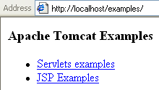
INTEGRATING APACHE WEB SERVER (MOD_PROXY)
Next we add the following setting in http.conf:
<VirtualHost *:80>
ServerAdmin webmaster@localhost
ServerName localhost
DocumentRoot "C:/Program Files/Apache Software Foundation/Apache2.2/htdocs/"
ProxyPass /examples http://localhost:8080/examples
ProxyPassReverse /examples http://localhost:8080/examples
</VirtualHost>
We configure a virtual host for all requests coming on port 80 and the root directory where all static content will be loaded from. The directives: VirtualHost, ServerAdmin ServerName, and DocumentRoot are part of the common Apache configuration. To proxy requests to the backend Tomcat server, we must first invoke a ProxyPass directive. This will make any request to Apache on port 80 be forwarded to Tomcat – regardless if it’s a servlet or static content that needs to be served. ProxyPassReverse takes care of any internal redirects that happen within a web application deployed on Tomcat. When such a redirect happens, the Location HTTP header will contain the redirect URL as it’s used on Tomcat (something like http://localhost:8080/example/index.html). That’s where ProxyPassReverse kicks in. For such redirects, this directive modifies the Location header, using the rule specified in the directive parameters so it will change any http://localhost:8080/examples redirects to /examples path on localhost.

Slide 63
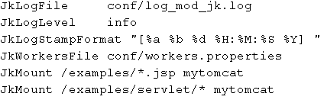
INTEGRATING APACHE WEB SERVER (MOD_JK)
Another protocol used for Httpd and Tomcat communication is Apache JServ Protocol (AJP). AJP protocol carries the same data as HTTP, but in an optimized, binary format. Apache provides an implementation of AJP protocol as part of its Tomcat Connectors subproject (or mod_jk).
The latest version of AJP protocol is AJP 1.3. Earlier AJP 1.2 is deprecated from Tomcat 3.3, and has not been supported by Tomcat since version 4.
After downloading mod_jk module(link: http://tomcat.apache.org/download-connectors.cgi) we need to load this Apache module.
LoadModule jk_module modules/mod_jk.so
AJP integration requires one additional configuration file to be included with Apache: workers.properties. This file will contain the entire required configuration for the Tomcat instance that Apache will talk to.
worker.list=mytomcat
worker.mytomcat.port=8009
worker.mytomcat.host=127.0.0.1
worker.mytomcat.type=ajp13
We set the port of the Tomcat’s AJP connector, as defined in server.xml file, in our case 8009 and the protocol: standard AJP 1.3 protocol.
<Connector port="8009" protocol="AJP/1.3" redirectPort="8443" />
httpd.conf →

Slide 64
EMBEDDING TOMCAT
Apache Tomcat 7 has a special version for embedding purposes that can be downloaded from http://tomcat.apache.org/download-70.cgi, in the Embedded section.
The archive file contains a number of JAR files that are used as library files for Java projects with embedded Tomcat.
tomcat-embed-core.jar → Core Tomcat classes, containing main implementation of the Tomcat server.
tomcat-dbcp.jar → Apache DBCP integration classes, used for JDBC integration.
tomcat-embed-jasper.jar → Tomcat’s JSP engine
tomcat-embed-logging-juli.jar → JULI logging library.
tomcat-embed-logging-log4j.jar → Log4j logging library
ecj-3.6.2.jar → Eclipse’s JSP compiler, used by the Jasper engine to compile JSP files.
Tomcat ships with a few implementations of the LifecycleListener interface, such as ServerLifecycleListener (for initialization of MBean for JMX management), GlobalResourcesLifecycleListener (for initialization of global JNDI resources), JasperLifecycleListener (loads the Jasper JPS engine before any web application that requires it).
AprLifecycleListener listener checks for the presence of the Apache Portable Library (APR) on the classpath and loads it if present. APR native library is high performance library used by Apache HTTP server and adds better scalability and integration on performance capabilities to the Apache Tomcat server.

Slide 65
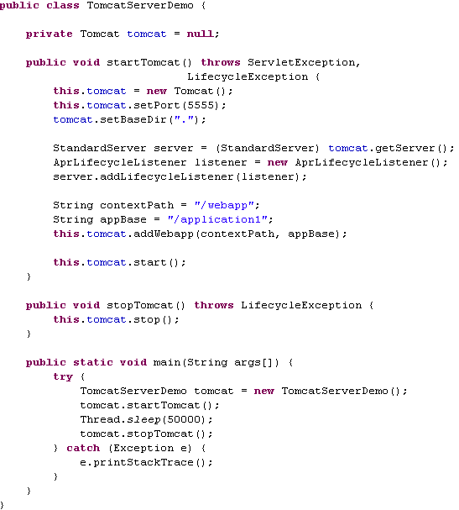
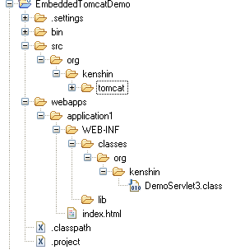

EMBEDDING TOMCAT (CONT.)

Slide 66
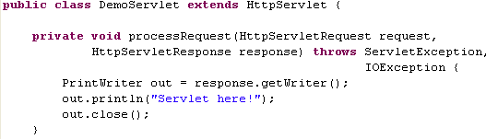
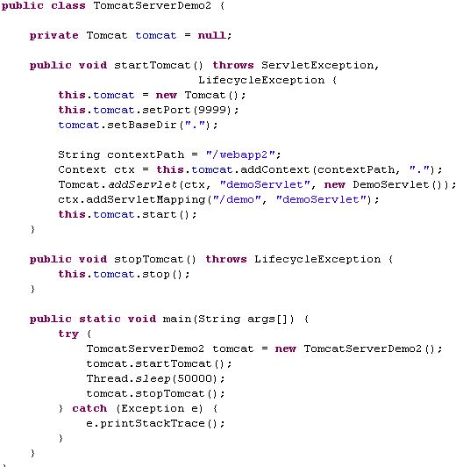
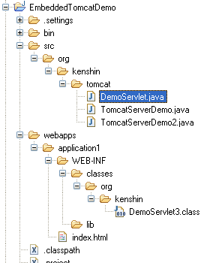

EMBEDDING TOMCAT (CONT.)

Slide 67
CONCLUSION

Slide 68
BIBLIOGRAPHY
Apress - Apache.Tomcat.7 - Aleksa Vukotic and James Goodwill
http://tomcat.apache.org/tomcat-7.0-doc/
http://en.wikipedia.org/wiki/Apache_Tomcat
http://www.developer.com/java/web/article.php/10935_3904871_2/Top-7-Features-in-Tomcat-7-The-New-and-the-Improved.htm
http://www.slf4j.org

Slide 69
QUESTIONS?

